Slide 1
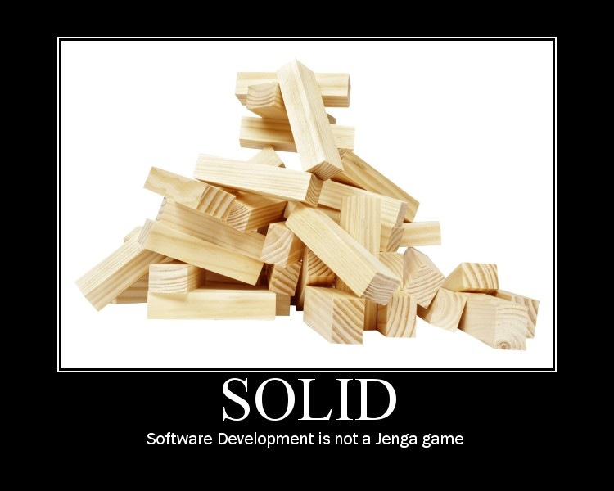

Slide 2
S.O.L.I.D. Software Development
Achieving Object Oriented Principles, One Step At A Time
Presented By:
Derick Bailey
Presentation Copyright ©2011 Muted Solutions, LLC

Slide 3
Coupling
Coupling:
“The degree to which each program module relies on each one of the other modules” – Wikipedia

Slide 4
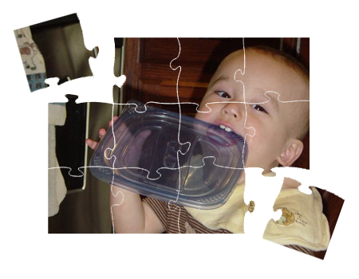
Cohesion
Cohesion:
“A measure of how strongly-related and focused the various responsibilities of a software module are” - Wikipedia

Slide 5
encapsulation
Encapsulation:
“The hiding of design decisions in a computer program that are most likely to change” - Wikipedia
?

Slide 6
SOLID Principles
SRP: Single Responsibility Principle
OCP: Open Closed Principle
LSP: Liskov Substitution Principle
ISP: Interface Segregation Principle
DIP: Dependency Inversion Principle

Slide 7
SRP: Single Responsibility Principle
One Responsibility – One Reason To Change
“If a class has more then one responsibility, then the responsibilities become coupled. Changes to one responsibility may impair or inhibit the class’ ability to meet the others. This kind of coupling leads to fragile designs that break in unexpected ways when changed.”
- Robert C. Martin

Slide 8
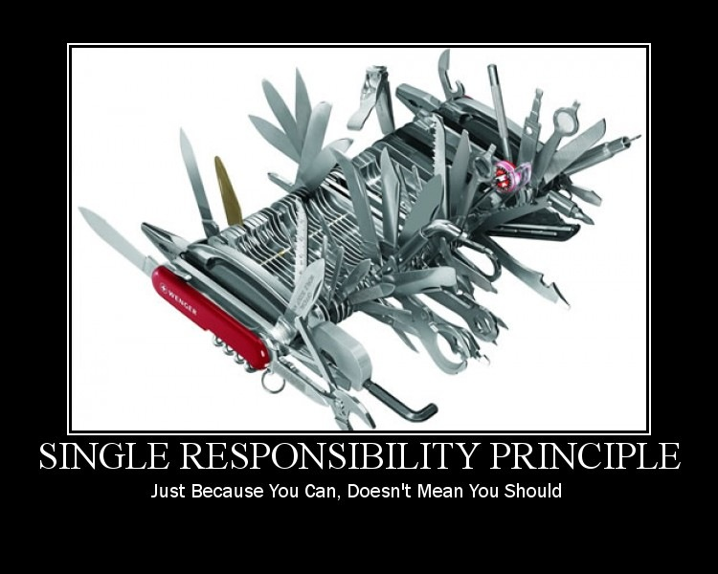

Slide 9
Single Responsibility
Example App: Read A Flat File And Send An Email
Email Sending App
File

Slide 10
Single Responsibility
Email Sending App
Email Sender
Flat File
XML File

Slide 11
Single Responsibility
Email Sending App
Email Sender
Flat File
XML File

Slide 12
Single Responsibility
Email Sender
Format Reader
Flat File
XML File

Slide 13
OCP: Open Closed Principle
Change The Behavior Without Changing The Existing Code
Modules that conform to open-closed have two primary attributes:
They are “Open For Extension”
They are “Closed for Modification”
- Robert C. Martin

Slide 14
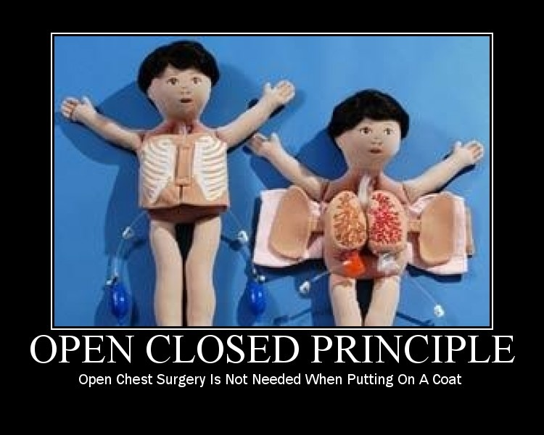

Slide 15
Open-Closed
File Reader
Service
Email Sender
IFile Format Reader
Flat File
XML File

Slide 16
LSP: Liskov Substitution Principle
Derived Classes Must Be Semantically Substitutable For Their Base Classes
“If for each object o1 of type S there is an object o2 of type T such that for all programs P defined in terms of T, the behavior of P is unchanged when o1 is substituted for o2 then S is a subtype of T.”
- Barbara Liskov

Slide 17
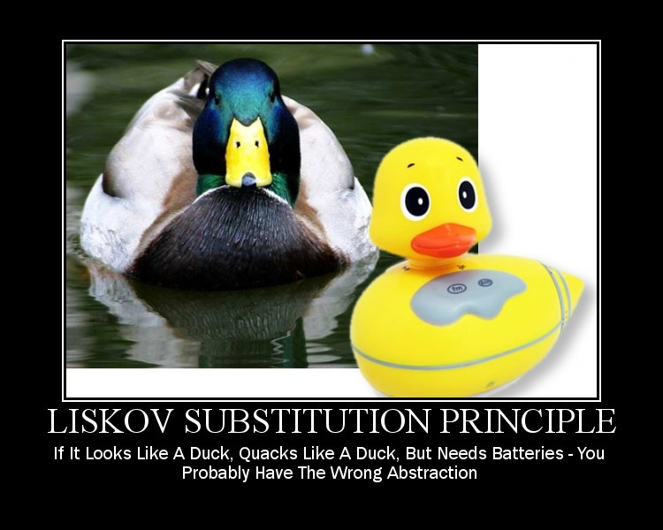

Slide 18
Liskov Substitution
Square
Rectangle
!=

Slide 19
Liskov Substitution
Database
FileReader
Service
Email Sender
IFileFormat Reader
Flat File
XML File
Database Connection File

Slide 20
Liskov Substitution
Database
Database
Reader
Service
Flat File
Email Sender
IFileFormat Reader
FileReader
Service
XML File

Slide 21
ISP: Interface Segregation Principle
Role Specific Interfaces
“Classes that have ‘fat’ interfaces are classes whose interfaces are not cohesive. In other words, the interfaces of the class can be broken up into groups of member functions. Each group serves a different set of clients.”
- Robert Martin

Slide 22
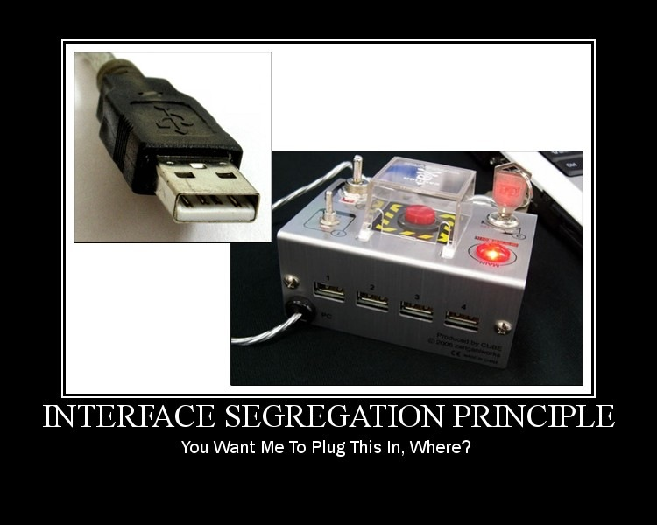

Slide 23
Interface Segregation
EmailSender
EmailSender
Database Reader
Service
SendEmail
ReadFile
ReadFromDb
SendEmail
GetMessageBody
FileReader
Service
GetMessageBody

Slide 24
DIP: Dependency Inversion Principle
Depend On Abstractions, Not Concrete Details And Implementations
“A design is rigid if it cannot be easily changed. Such rigidity is due to the fact that a single change to heavily interdependent software begins a cascade of changes in dependent modules.”
- Robert Martin

Slide 25
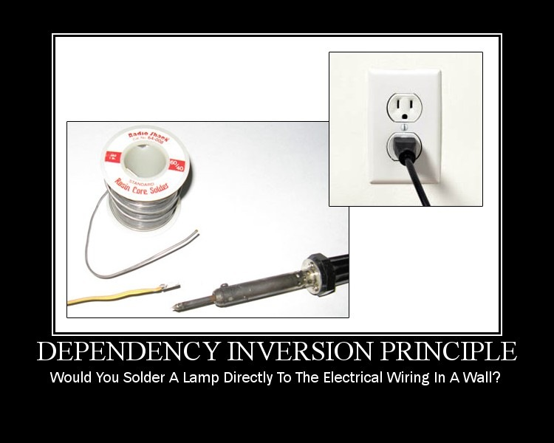

Slide 26
Dependency Inversion
Foo
Bar

Slide 27
Dependency Inversion
Foo
IBar
Bar

Slide 28
Dependency Inversion
Foo
IRoleName
Bar

Slide 29
Dependency Inversion
Xml File Reader
Flat File Reader
IFileFormat Reader
Database Reader Service
File Reader Service
Email Sender
IMessageInfoRetriever
IEmailService
ProcessingService

Slide 30
Summarizing Our S.O.L.I.D. Conversion
Compare And Contrast The Original Code To The New Code

Slide 31
What Did We DO?
IMessageInfo
Retriever
IEmailSender
Email Sending App
EmailProcessingService
Flat File
Database
Database
Reader
Service
IMessage
Info
Retriever
File
XML File
IFileFormat Reader
FileReader
Service
EmailService
IEmail
Service
Before
After

Slide 32
Why? … Coupling
IMessageInfo
Retriever
IEmailSender
EmailProcessingService
Flat File
Database
Database
Reader
Service
IMessage
Info
Retriever
XML File
IFileFormat Reader
FileReader
Service
EmailService
IEmail
Service

Slide 33
Why? … Cohesion
IMessageInfo
Retriever
IEmailSender
EmailProcessingService
Flat File
Database
Database
Reader
Service
IMessage
Info
Retriever
XML File
IFileFormat Reader
FileReader
Service
EmailService
IEmail
Service

Slide 34
Why? … Encapsulation
IMessageInfo
Retriever
IEmailSender
EmailProcessingService
Flat File
Database
Database
Reader
Service
IMessage
Info
Retriever
XML File
IFileFormat Reader
FileReader
Service
EmailService
IEmail
Service

Slide 35
Additional Resources
Uncle Bob’s Principle Of Object Oriented Development:
http://butunclebob.com/ArticleS.UncleBob.PrinciplesOfOod
Pablo’s Topic Of The Month on SOLID, and Pablo’s SOLID E-Book
http://lostechies.com
Agile Principles, Patterns, And Practices In C#
by Robert (Uncle Bob) Martin and Micah Martin
SOLID Software Development in CODE Magazine
http://www.code-magazine.com/article.aspx?quickid=1001061

Slide 36
About Me… Derick Bailey
Independent Consultant and Chief Ninja @ Muted Solutions, LLC
WWW: mutedsolutions.com derickbailey.lostechies.com
Email: derick@mutedsolutions.com derick@derickbailey.com
Twitter: @derickbailey

